Slide 1
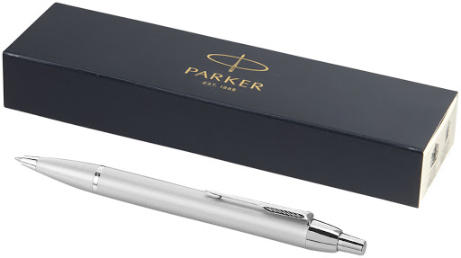
Educational
.
Does the problem focus on human values
Design thinking
Problem solving
Changing products according to trends
Create a product in this class
Empathy – what do customers want / real problem
Define or redefine the problem (pen)
Ideas (50-60 ideas for the one problem) beyond rational thinking (boy)
Make Prototypes (needs to be interactive – cheap failure)
Test – How the audience perceives it
Don’t sit when generating ideas
How to solve a problem using design thinking
What is this?.
Welcome the impossible
.
Visualize
Draw
Paint
sketch
…
Be open to talk / be more curious / post our feelings
Christopher Bauman – www.chrisbauman.com.au

Slide 2
1. What is innovation? Describe an innovative product or idea? ____________________________________________________________________________________________?
Advanced Question Words
2. What are the benefits that you provide (not what you do) ___________________________________________________________________________________________ ?
filters
complete
Muddy the waters
Elegant
3. When have you moved forward unprepared ___________________________________________________________________________________________ ?
Captive audience
4 Let 100 flowers blossom ___________________________________________________________________________________________ ?
Empowering
5. Great products polarize people ___________________________________________________________________________________________ ?
Unexpected audience
Don’t be proud
Churn
6. Put whatever you are thinking about on a piece of paper ___________________________________________________________________________________________ ?
Denial
Rearrange your ideas
7. The innovation in design thinking happens when it is a team sport (Sally the accountant) ___________________________________________________________________________________________ ?
Niche thy self
reframe
8. What is a product that you love (Why) ____________________________________________________________________________________________ ?
Lucky Vs Smart
Create a product in this class
.
Christopher Bauman – www.chrisbauman.com.au

Slide 3
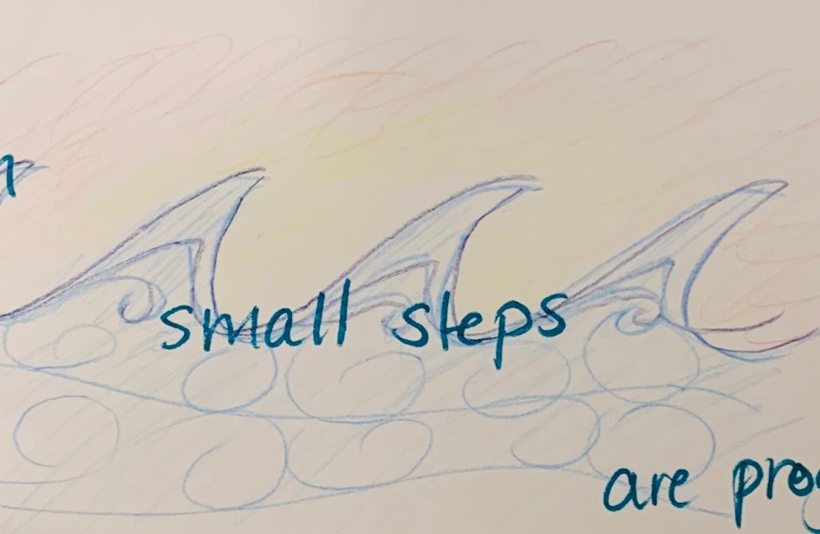
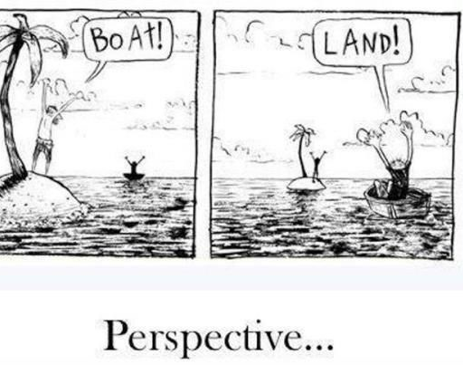
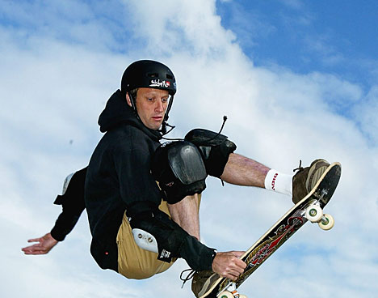

Slide 4
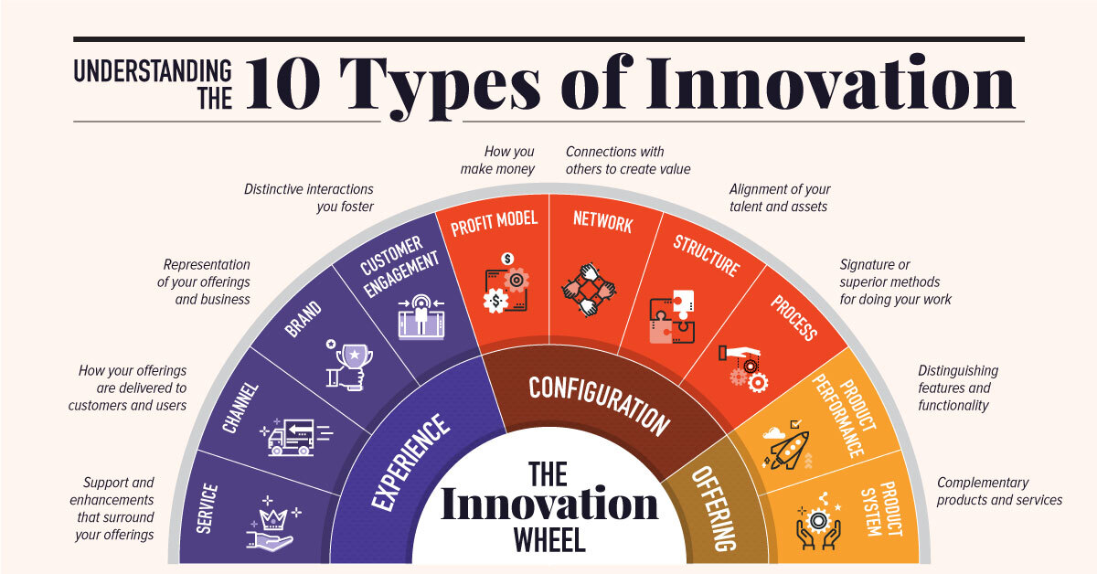
Brainstorming / sketching

